Slide 1
BACKWARDS DESIGN: ASSESSMENT, ALIGNMENT, QUALITY MATTERS, AND ONLINE LEARNING CONSORTIUM
Patricia Baia, PhD
Director of Online Learning and Instructional Technology, Albany Law School
Latia Ward, JD, MSLS
Research Services Librarian and Diversity Fellow, Cornell University Law Library
Margaret (Meg) Butler, JD, MS, MLS
Associate Director for Public Services, Georgia State University Law Library
CALIcon19
June 6, 2019

Slide 2
BACKWARDS DESIGN
Patricia Baia, PhD
Director of Online Learning and Instructional Technology, Albany Law School
pbaia@albanylaw.edu
CALIcon19
June 6, 2019

Slide 3
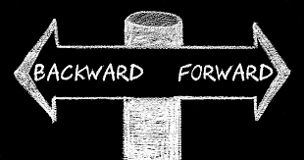
What is Backwards Design?
Start with the end in mind
It suggests a planning sequence for curriculum
Wiggins, G. P., McTighe, J., Kiernan, L. J., Frost, F., (1998). Understanding by design. Alexandria, Va: Association for Supervision and Curriculum Development.

Slide 7
Framing…..Assessing……Designing
Quality Matters (QM)
Online Learning Consortium (OLC)
QM Higher Education Rubric, Sixth Edition
© 2018 MarylandOnline, Inc. All rights reserved. This document may not be copied or duplicated without written permission of Quality Matters.
For more information or access to the fully annotated QM Rubric, visit qualitymatters.org or email info@qualitymatters.org
Quality Score Cards Suite
The OSCQR Rubric, Dashboard, and Process are made available by Online Learning Consortium, Inc. (OLC) under the Creative Commons Attribution 4.0 International License (CC By 4.0). https://onlinelearningconsortium.org/
The OSCQR Rubric, Dashboard and Process were originally developed by the State University of New York, through the Open SUNY® Center for Online Teaching Excellence.

Slide 8
Program Outcomes
Learning Objectives
Assessment and Feedback
Active Learning
Strategic Outcomes
Communication Modes (Cognitive Inquiry Model)
Multi-modal Teaching
Organization/Consistency
Course Goals
Alignment/Closing the loop

Slide 9
Use backwards design to meet aba standards
Margaret (Meg) Butler, JD, MS, MLS
Associate Director for Public Services, Georgia State University Law Library
mbutler@gsu.edu
CALIcon19
June 6, 2019

Slide 10
Overview
ABA Standards related to learning outcomes, competencies, and online education
ABA Standards related to assessment of learning and program
Review of assessment
Think, pair, share activity (time permitting)

Slide 11
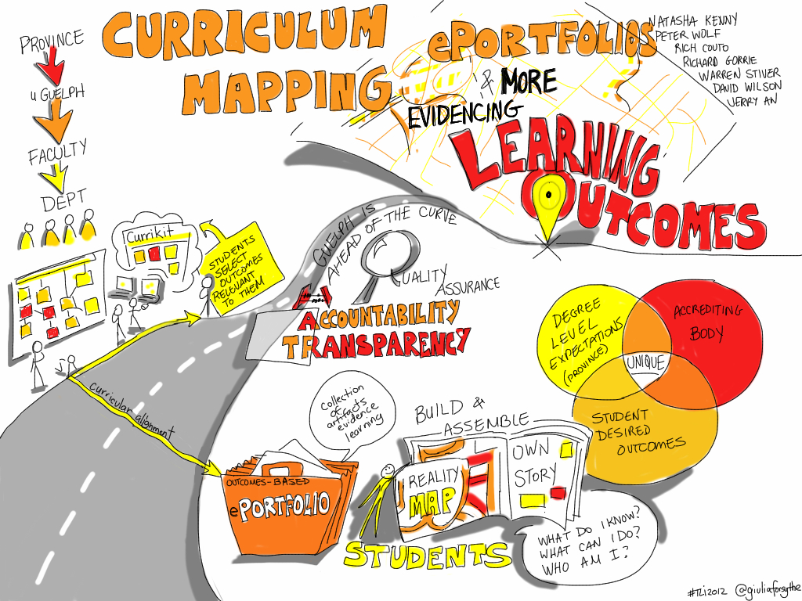
ABA Standards: Learning Outcomes
301: Learning outcomes must be established and published

Slide 12
Columbia University Law School

Slide 13
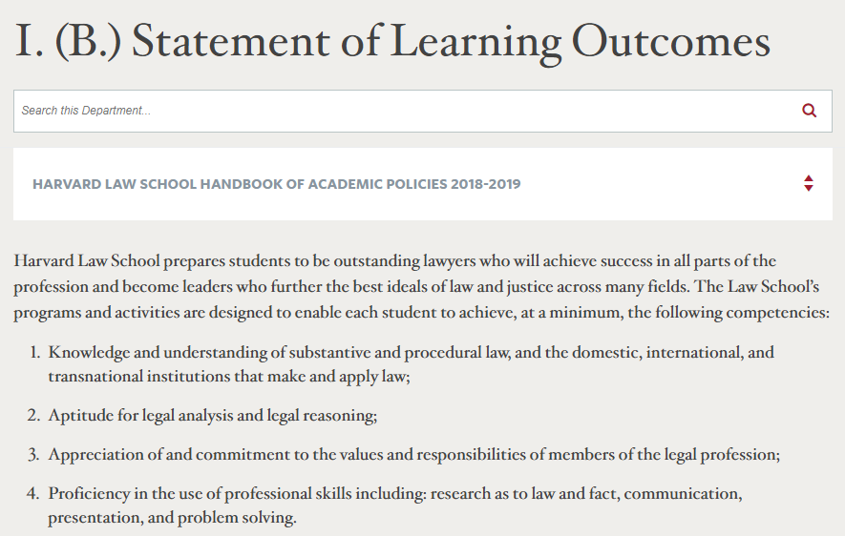
Harvard Law School

Slide 14
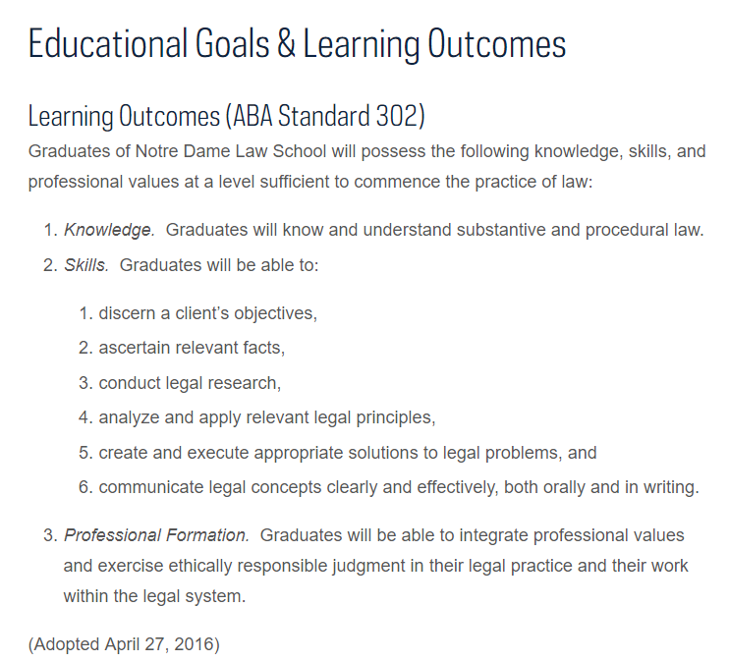
Notre Dame Law School

Slide 15
ABA Standards: Competencies Described
302: Learning outcomes must be established and include competency in the following:
Substantive and procedural law
Analysis & reasoning, research, problem-solving, and communication
Fulfill proper professional and ethical responsibilities
Other professional skills needed
Interpretations
Other professional skills may be determined by the law school, and many are listed
Schools may add more outcomes that are “pertinent” to its program

Slide 16
ABA Standards: Online Education
306: Learning outcomes in distance education courses must be consistent with the Standard 302 for the course to count toward graduation

Slide 17
ABA Standards: Assessment of Learning and Program
314: Law schools shall use formative and summative assessments to measure and improve student learning and provide feedback to students
315: Dean and faculty shall evaluate the program of education and use results of evaluation to make needed changes to improve curriculum.

Slide 18
Assessment
Types of assessment
Formative
Summative
Peer
Self
Benefit to student
Cognitive
Affective
Corrective instruction

Slide 20
Image Credits
Guilia Forsyth, @natashakenny et al: #TLI2012 Curriculum Planning, ePortfolios & More. Evidencing Learning outcomes available at: https://www.flickr.com/photos/gforsythe/7132980349.
Columbia University Law School, "Learning Outcomes," https://www.law.columbia.edu/admissions/jd/learning-outcomes.
Harvard Law School, "I. (B.) Statement of Learning Outcomes," https://hls.harvard.edu/dept/academics/handbook/rules-relating-to-law-school-studies/requirements-for-the-j-d-degree/first-year-j-d-course-and-credit-requirements/.
Notre Dame Law School, "Educational Goals & Learning Outcomes," https://law.nd.edu/about/educational-goals-and-learning-outcomes/.
LeanForward If, "Online Learning," available at: https://www.flickr.com/photos/125135071@N06/15071668497.
Technovore, "Formative vs. Summative Assessment," available at: https://www.flickr.com/photos/krillion/27886923042.
Guilia Forsythe, "Workshop Materials," available at:
https://www.flickr.com/photos/gforsythe/46852974881/.
Guilia Forsythe, "Think Pair Share," available at: https://www.flickr.com/photos/gforsythe/26714165840.
All images retrieved 5/20/2019.

Slide 21
Backwards design and rubrics
Latia Ward, JD, MSLS
Research Services Librarian and Diversity Fellow, Cornell University Law Library
latiaward@cornell.edu
CALIcon19
June 6, 2019

Slide 22
rubrics
Rubrics are used to assess student work.
Rubrics benefit students.
Rubrics benefit teachers.
Bibliography

Slide 23
Three Points about rubrics
Make the rubric user-friendly for both the instructor and the student.
Tailor your rubric to the assignment.
Use resources that are readily available.
Bibliography

Slide 24
timeline rubric
Categories
 | Excellent | Good | Needs Improvement
Quality of content | Included events are important and interesting. No major details are excluded. | Most of the included events are important or interesting. One or two major events may be missing | Some events included are trivial, and major events are missing.
Quantity of facts | The timeline contains at least 8–10 events related to the topic being studied. | The timeline contains at least 6–7 events related to the topic being studied. | The timeline contains at least 5 events related to the topic being studied.
Accuracy of content | Facts are accurate for all events reported on the timeline. | Facts are accurate for almost all events reported on the timeline. | Facts are accurate for most (~75%) of the events reported on the timeline.
Sequence of content | Events are placed in proper order. | Almost all events are placed in proper order. | Most (~75%) of the events are placed in proper order.
Dimensions
Timeline Rubric at readwritethink.org

Slide 25
Types of rubrics
View the example of a holistic rubric from the Types of Rubrics webpage of the University of Minnesota’s Center for Advanced Research on Language Acquisition (CARLA). (permanent link)
View the example of an analytic rubric from the Types of Rubrics webpage of the University of Minnesota’s CARLA. (permanent link)
View the example of a single-point rubric at Jennifer Gonzalez’s blog. Gonzalez is a National Board Certified Teacher and teaches pre-service teachers. (permanent link)

Slide 26
Resources for creating rubrics
tinyurl.com/CALIcon19-Design-Slides
Rubric-Makers
Rubistar
Quick Rubric
Rubric Maker
iRubric
Sample Rubrics
Designing Grading Rubrics by Brown University
Rubrics by Berkeley Center for Teaching and Learning
Grading and Performance Rubrics by Carnegie Mellon University
Rubric Bank by University of Hawai’i at Mānoa
tinyurl.com/CALIcon19-Design

Slide 27
BIBLIOGRAPHY - rUBRICS
David Balch, Robert Blanck & David Howard Balch, Rubrics--Sharing the Rules of the Game, 5 Journal of Instructional Research 19–49 (2016), https://eric.ed.gov/?id=EJ1127629 (last visited May 13, 2019).
Phillip Dawson, Assessment rubrics: towards clearer and more replicable design, research and practice, 42 Assessment & Evaluation in Higher Education 347–360 (2017), https://www.tandfonline.com/doi/full/10.1080/02602938.2015.1111294 (last visited Apr 6, 2019).
Jarene Fluckiger, Single Point Rubric: A Tool for Responsible Student Self-Assessment, The Delta Kappa Gamma Bulletin 18–25 (2010), https://digitalcommons.unomaha.edu/tedfacpub/5.
W. James Popham, What’s wrong--and what’s right--with rubrics, 55 Educational Leadership; Alexandria 72–75 (1997), https://search.proquest.com/docview/224857225/abstract/5714E3FE2D27407CPQ/21 (last visited Apr 8, 2019).
Dannelle D. Stevens & Antonia Levi, Introduction to rubrics: an assessment tool to save grading time, convey effective feedback, and promote student learning (2nd ed. 2013).
Hugh A. Stoddard, Cory A. Labrecque & Toby Schonfeld, Using a Scoring Rubric to Assess the Writing of Bioethics Students Bioethics Education, 25 Cambridge Q. Healthcare Ethics 301–311 (2016), https://heinonline.org/HOL/P?h=hein.journals/cqhe25&i=322 (last visited Apr 6, 2019).

